Slide 1

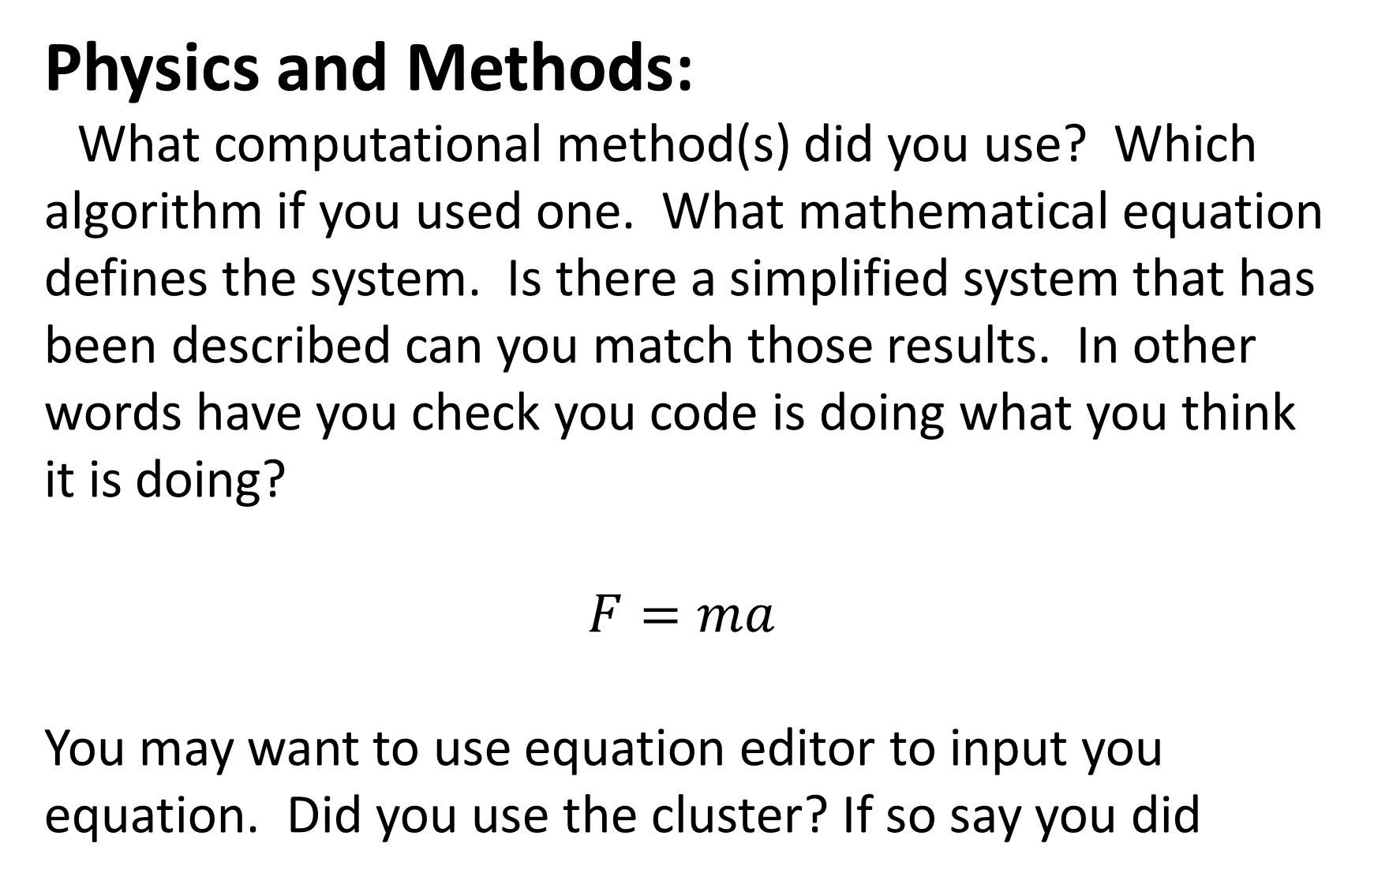
The Gambler’s Ruin: Mathematics of Gambling
Omair Alam, Computational Methods in Physics, Spring 2015
Introduction:
Gamblers know that there are regular patterns to chance—although not all of their cherished beliefs survive mathematical analysis. In order to test the validity of their beliefs we using Monte-Carlo simulations to calculate the average earnings or losses in a game of die rolls under varying rules of winning. We further simulate a game of Craps with both a biased and unbiased die. For a dice roll game, we use a Binomial Distribution to model the expected earnings while for a Craps game, we use axiomatic derivations to calculate the expected probability of winning. We then compare the expected earnings with the actual earnings for a varying number of repetitions to understand the fate of the Gambler’s money after betting under certain game rules repeatedly.
Figure 5. Figure caption should give enough detail to describe the figure above with out reading much else
Figure 2. Figure caption should give enough detail to describe the figure above with out reading much else
Physics and Methods:
What computational method(s) did you use? Which algorithm if you used one. What mathematical equation defines the system. Is there a simplified system that has been described can you match those results. In other words have you check you code is doing what you think it is doing?
$$F=ma$$
You may want to use equation editor to input you equation. Did you use the cluster? If so say you did
Figure 3. Figure caption should give enough detail to describe the figure above with out reading much else
Figure 4. Figure caption should give enough detail to describe the figure above with out reading much else
Figure 6. Figure caption should give enough detail to describe the figure above with out reading much else
Conclusions or Discussion:
Give an overall conclusion of your results. What do they show. Is there agreement with experimental data? Or observation? What is the big picture. Include any problems, corrections and limitations to you code. Interesting next steps…
Results:
Write the results of you problem. We saw this… as shown in figure 1. The figures should display most of your results from the project this is an additional area for words but remember figures are better than words. For example with shooting the sun you can show a few plots where you track a projectile. One where you tested you code by orbiting the sun with the projectile and eliminating the earth. Then one or two with example trajectories. Then figure X showing the plot of many angles and launch velocities. You should reference every figure.
References:
Text 1 that was used
Article 2 that was used
Reference 3 that was use
Figure 1. Figure caption should give enough detail to describe the figure above with out reading much else

